Slide 1

Knowledge Extraction, Data Modeling and Visualisation
UNIT 4 – DATA PREPROCESSING
Stefan Apostol, PhD., Researcher, Lecturer
Vienna Institute for Global Studies

Slide 2

Admin
AGENDA
01
What is Data Pre-processing
02
Why Data Pre-processing
03
ETL
04
Data Cleaning Process
05
Missing data
06
Tools

Slide 3
Introduction
WHAT IS DATA PREPROCESSING
01
A step in the process
What is Data Preprocessing
Real-world datasets are generally messy, raw, incomplete, inconsistent, and unusable. It can contain manual entry errors, missing values, inconsistent schema, etc. Data Preprocessing is the process of converting raw data into a format that is understandable and usable. It is a crucial step in any Data Science project to carry out an efficient and accurate analysis. It ensures that data quality is consistent before applying any Machine Learning or Data Mining techniques.
02
Cleaning the data
03
Aligning the format
04
So that it can be analysed

Slide 4

Introduction
IMPORTANCE
Garbage in Garbage out (GIGO)
01
Wrong population
02
Wrong measurements
03
Wrong format of question
04
Wrong depth of data
05
Wrong quality

Slide 5
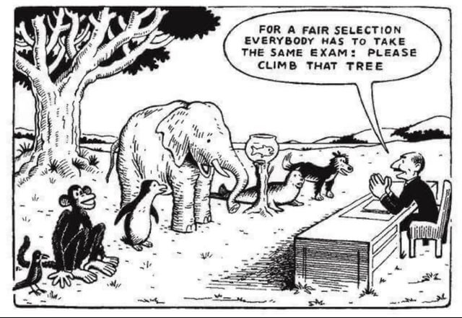
Introduction
WRONG POPULATION

Slide 6
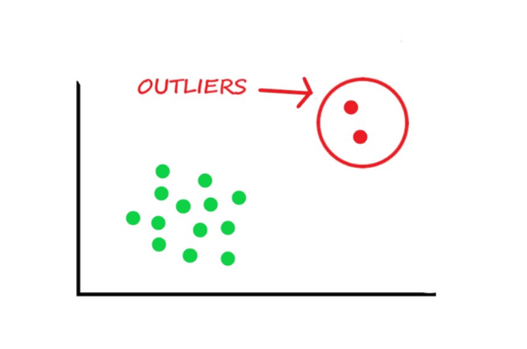
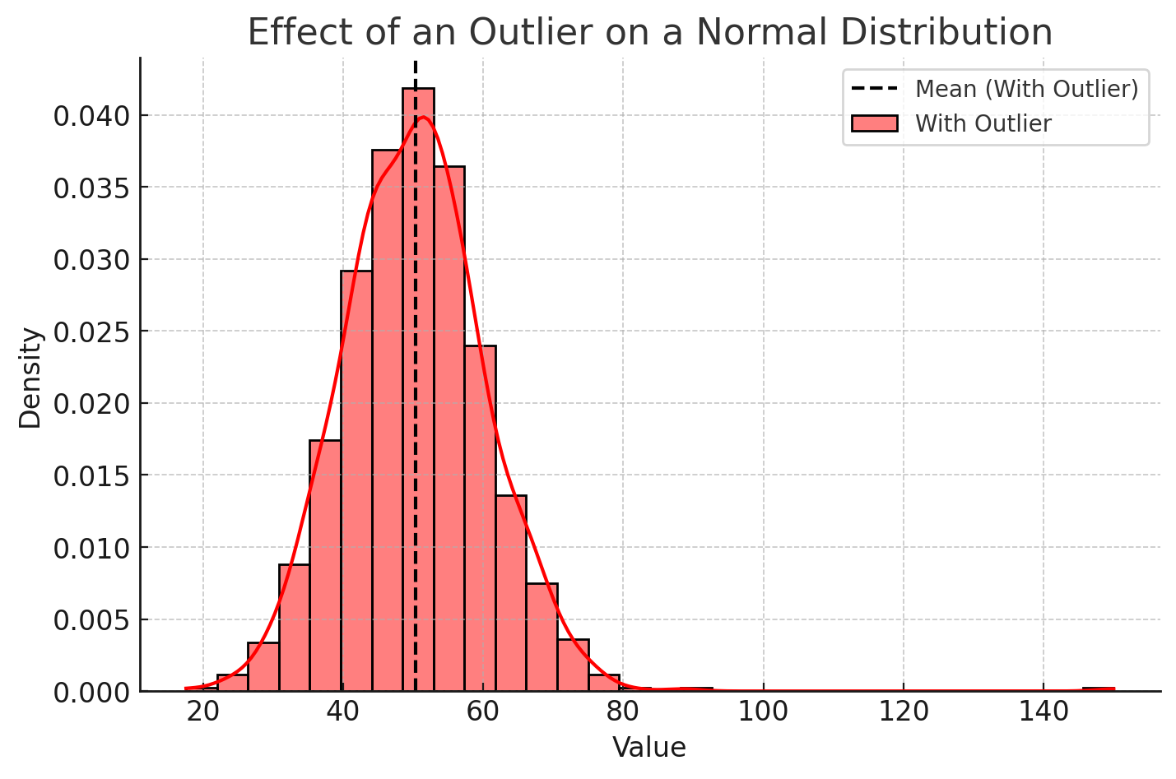
Introduction
WRONG POPULATION

Slide 7
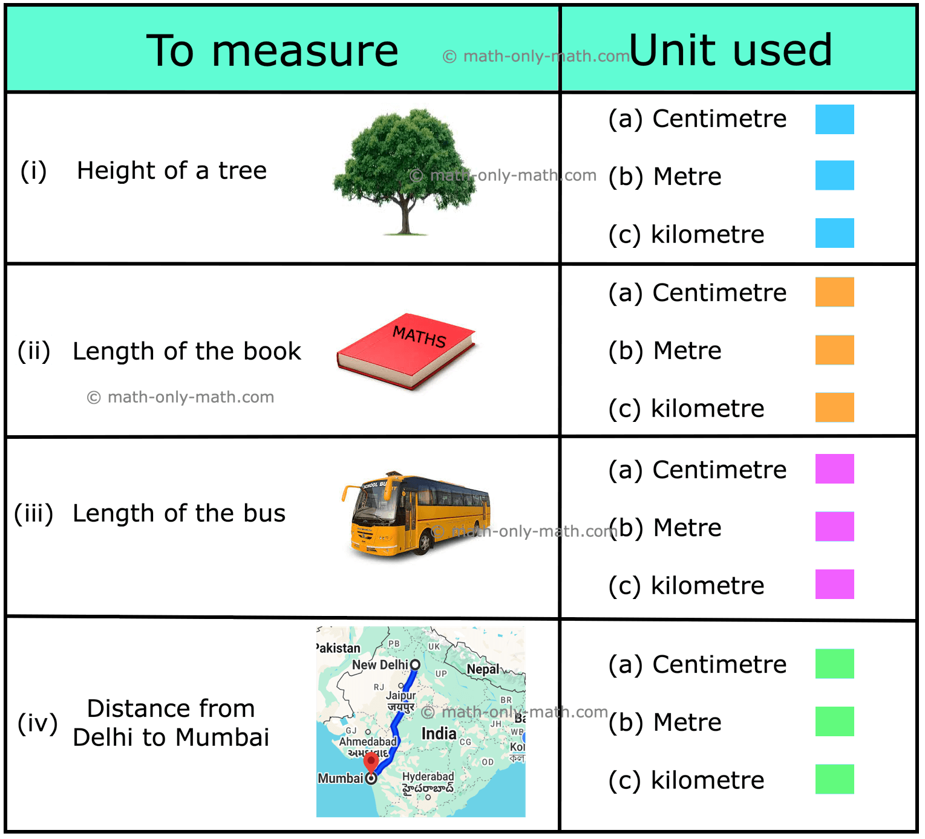
Introduction
WRONG MEASUREMENT

Slide 8
Introduction
WRONG FORMAT OF QUESTIONS
What’s your favorite food?
Choclate Chocollate Choclatee Chocoolate Choc Choco Choccy Choc. Chocky CHOCOLATE chocolate Chocolate Chocolate Chocolate Chocolate. Chocolate!
Chocolat Schokolade
Cioccolato Chocolade Dark Chocolate Milk Chocolate White Chocolate Hot Chocolate Chocolate Ice Cream 🍫 Choco 🍫 Chock-lit Choco-luv Chocobae Choco vibez Choccy milk
Big Choc Energy Choc attack Dripolate Choco Supreme Skibidi Chocolate Choco Skibidi Rizzz Hershey’s Lindt Ferrero Cadbury Godiva Toblerone Ghirardelli KitKat Snickers Twix
Milky Way Reese’s Kinder Galaxy Dove Chocolate M&M’s Nutella

Slide 9
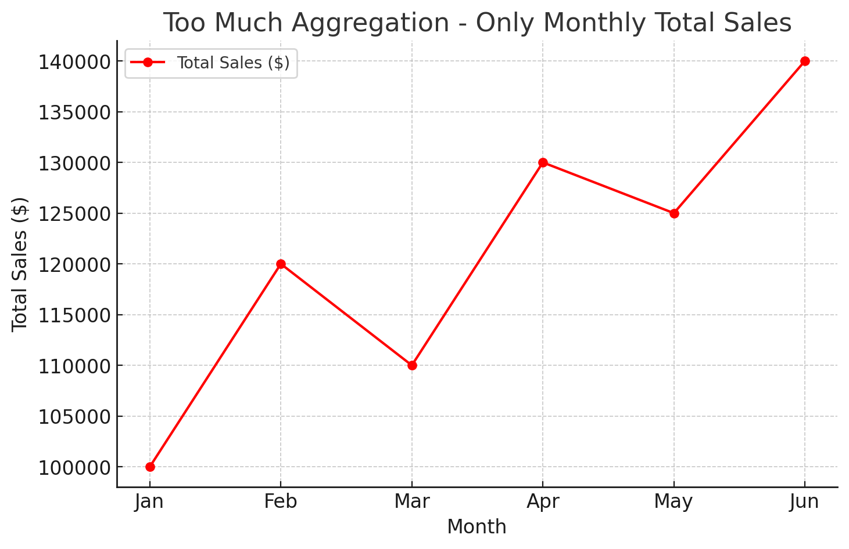
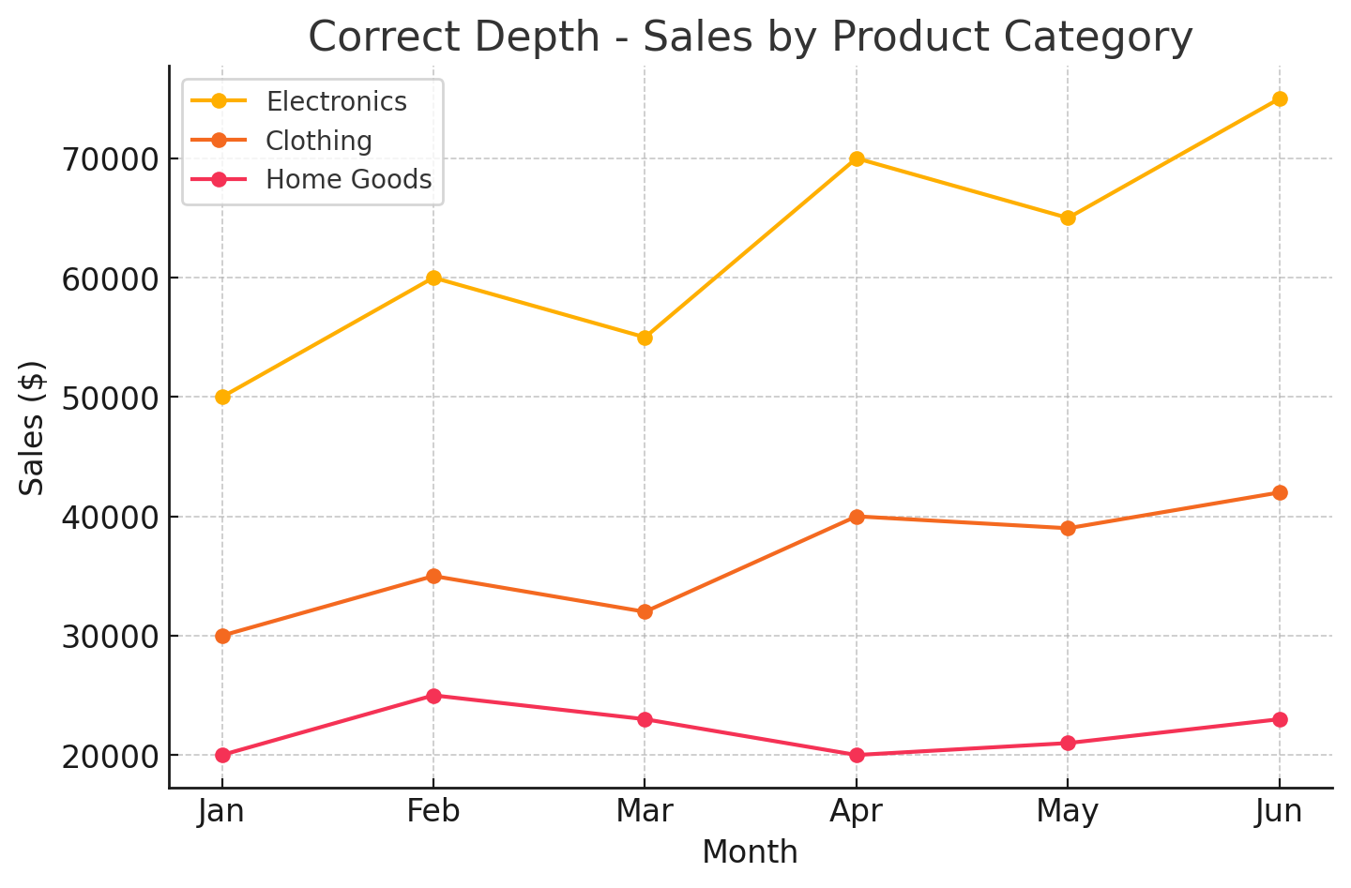
Introduction
WRONG DEPTH OF DATA

Slide 10
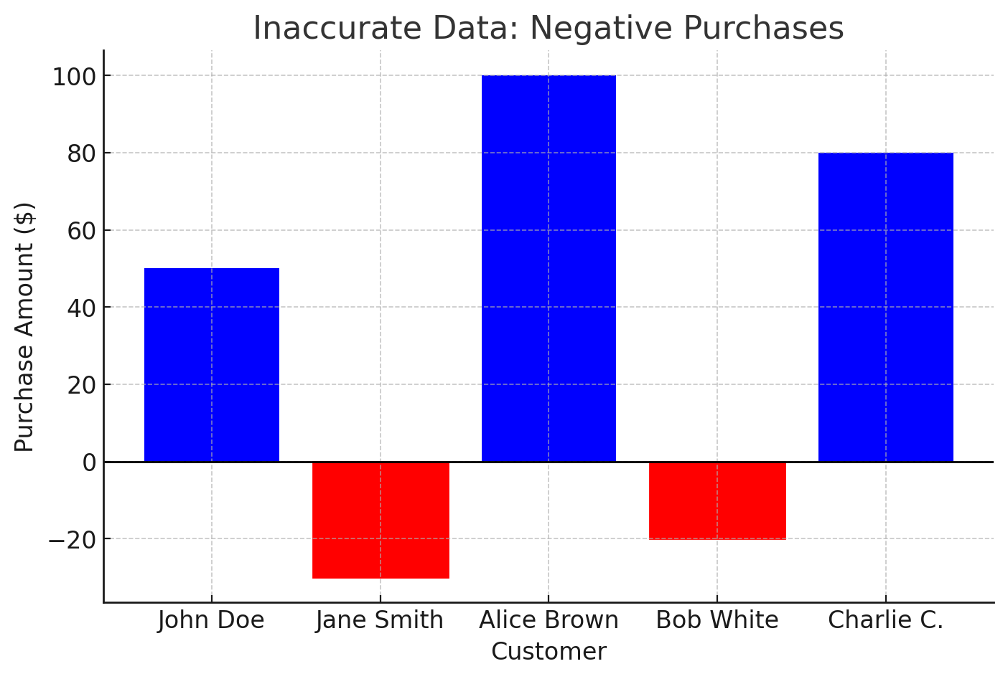
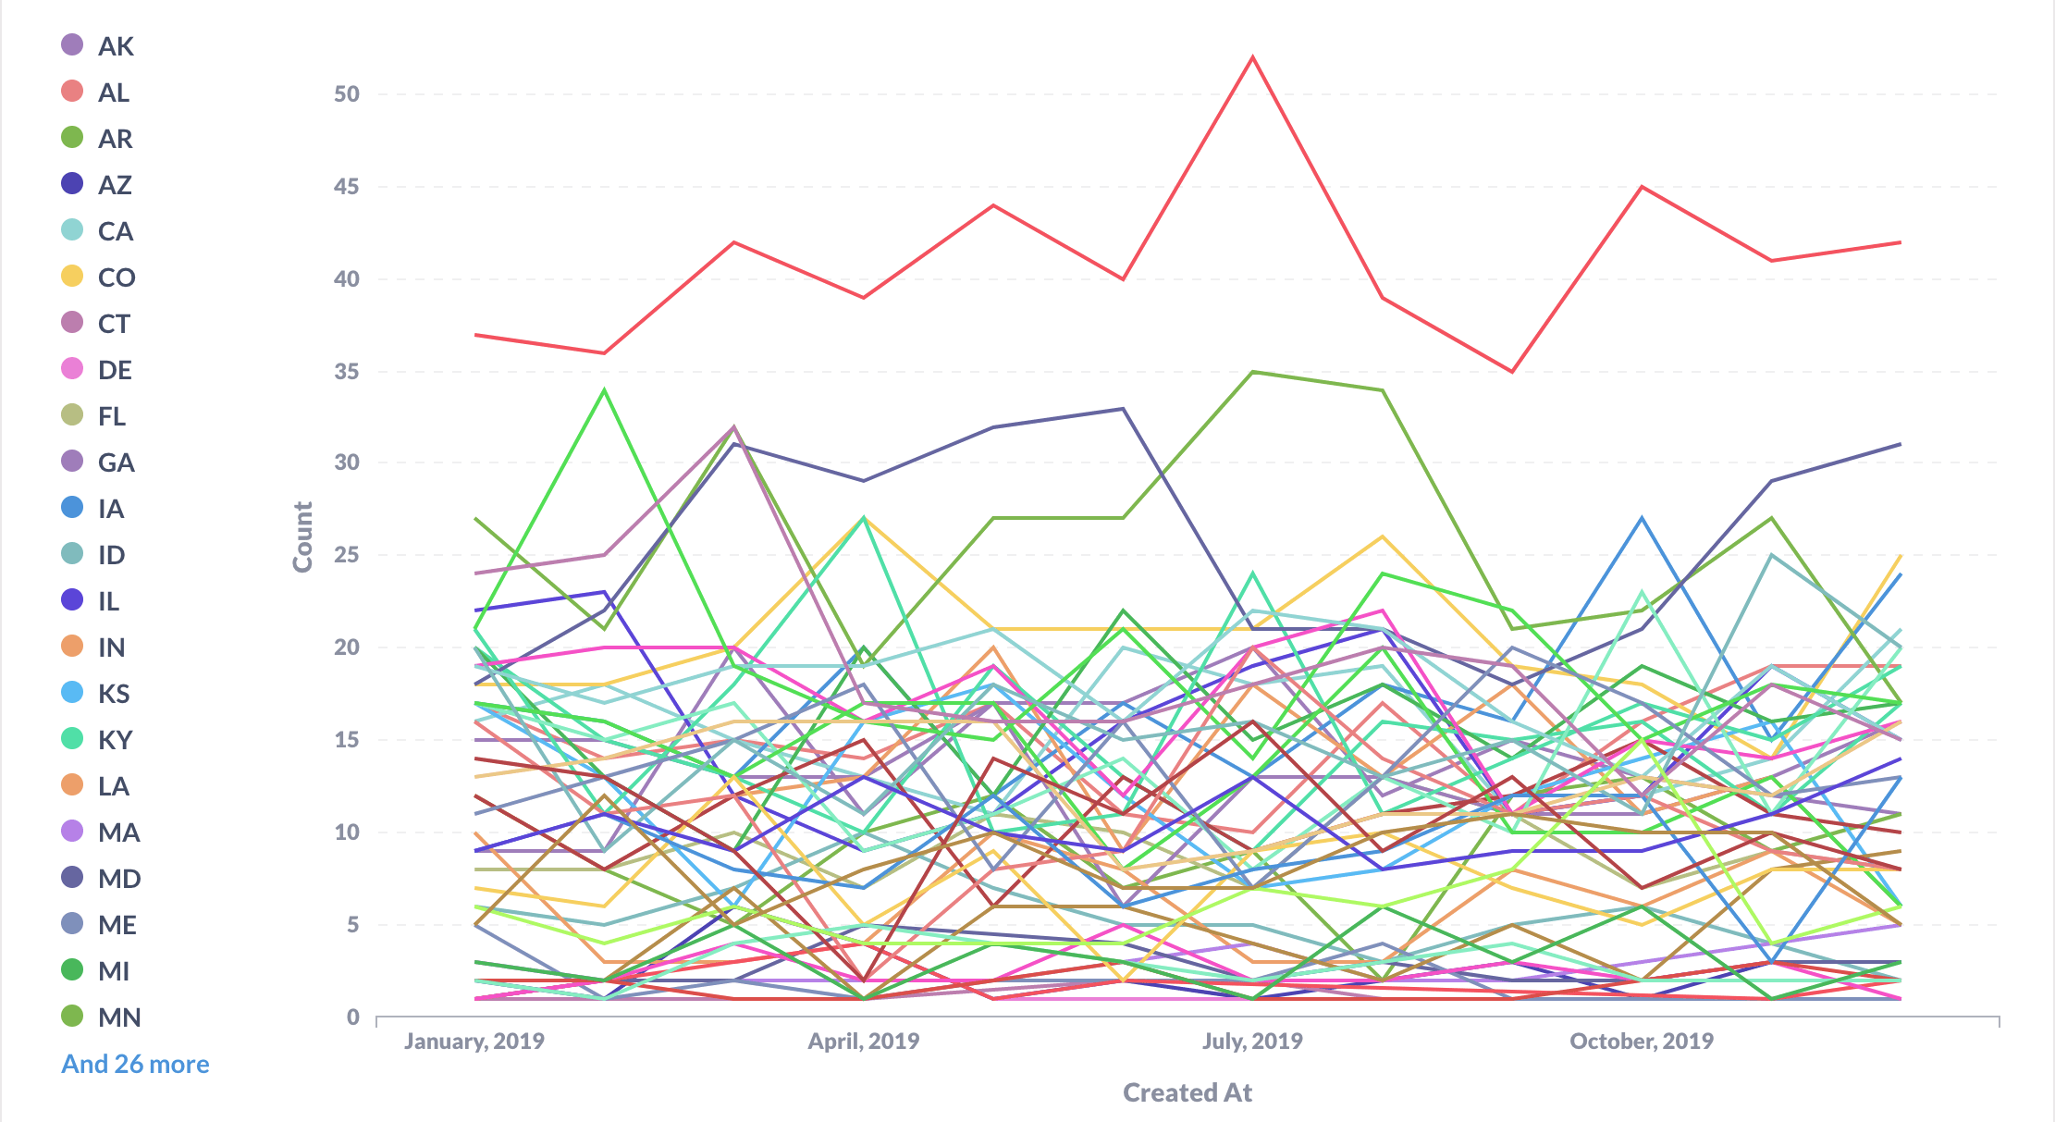
Introduction
WRONG DEPTH OF DATA

Slide 11
Introduction
ETL PROCESS
Sources
Targets
Data
collection
Pre-processing
Saving
Database
Data warehouse
Extract
Transform
Load
Database
App
Flat Files
…
…

Slide 12
Introduction
DATA CLEANING PROCESS
01
02
03
04
Assess the data quality
Data cleaning
Data transforming
Data reducing

Slide 13
Data pre-processing steps
ASSESS DATA QUALITY
01
Miss match data types
01
Bias results
02
Missing values
02
Misleading analysis
03
Noise
03
Reduced efficiency
04
Duplicates
04
Non-sensical findings

Slide 14

Data pre-processing steps
DATA CLEANING
01
Mis-match data types
02
Missing values
03
Noise
04
Duplicates

Slide 15
Data Cleaning
Mis-match data types
January 1, 2024 (US, informal)
1 January 2024 (UK, formal)
01/01/2024 (MM/DD/YYYY, common in the US)
1/1/2024 (M/D/YYYY, US, less formal)
01-01-2024 (DD-MM-YYYY, common in many parts of the world)
2024-01-01 (YYYY-MM-DD, ISO 8601 standard, widely used in international contexts)
20240101 (YYYYMMDD, compact form, often used in technical fields)
1st January 2024 (Day Month Year, more formal, UK)
Jan 1, 2024 (Abbreviated month, US informal)
1 Jan 2024 (Day Abbreviated Month Year, less formal, international usage)
01 Jan '24 (DD MMM 'YY, informal, with abbreviated year)
2024年01月01日 (Year Month Day, East Asian format, particularly in China and Japan)
01.01.2024 (DD.MM.YYYY, common in many European countries)
01/01/24 (MM/DD/YY, less formal, US)
January 1st, 2024 (Month Dayth, Year, US, more formal)

Slide 16
Data cleaning
Mis-match data types
$25.23 (Standard US format)
25.23 USD (International format, specifying the currency code)
US$25.23 (International usage, distinguishing US dollars from other dollar currencies)
Twenty-five dollars and twenty-three cents (US, in words)
$25 and 23 cents (Less formal, in words)
25 dollars 23 cents (Informal, without symbols)
$25,23 (In countries where a comma is used as a decimal separator)
25 USD 23¢ (Using currency code and cent symbol)
$25 23/100 (On checks, where cents are written as a fraction)
25.23$ (Less common, with the dollar sign following the amount)
25,23 dollars (Informal, especially in non-English speaking countries where comma is used asdecimal)
USD 25.23 (Formal, currency code leading)
$0025.23 (Technical or electronic formats where leading zeros might be used)
Twenty-five dollars and twenty-three cents exactly (For legal or formal documents, spelled out in words)
25.2300 dollars (With additional decimal places, possibly used in financial or accounting contexts to denote precision)

Slide 17
Data cleaning
MISSING DATA
01
Delete the rows
How will this effect things?
02
Enter the average value
How will this effect things?
03
Enter most probable value
How will this effect things?
04
Enter code for empty value
to ignore these values
How will this effect things?
05
Data simulation
How will this effect things?

Slide 18
Data pre-processing steps
MISSING VALUES
import numpy as np
import pandas as pd # Set seed for reproducibility
np.random.seed(42)
# Generate a normal distribution
full_data = np.random.normal(loc=50, scale=10, size=1000) # Mean=50, Std=10, Sample size=1000
# Introduce missing values (e.g., 40% missing data)
missing_mask = np.random.choice([True, False], size=full_data.shape, p=[0.4, 0.6]) # 40% missing
data_with_missing = full_data.copy()
data_with_missing[missing_mask] = np.nan # Assign NaN to missing values
# Convert to DataFrame
df_missing = pd.DataFrame({"Values": data_with_missing})
# save into excel file
df_missing.to_excel("missing_data.xlsx", index=False)

Slide 19
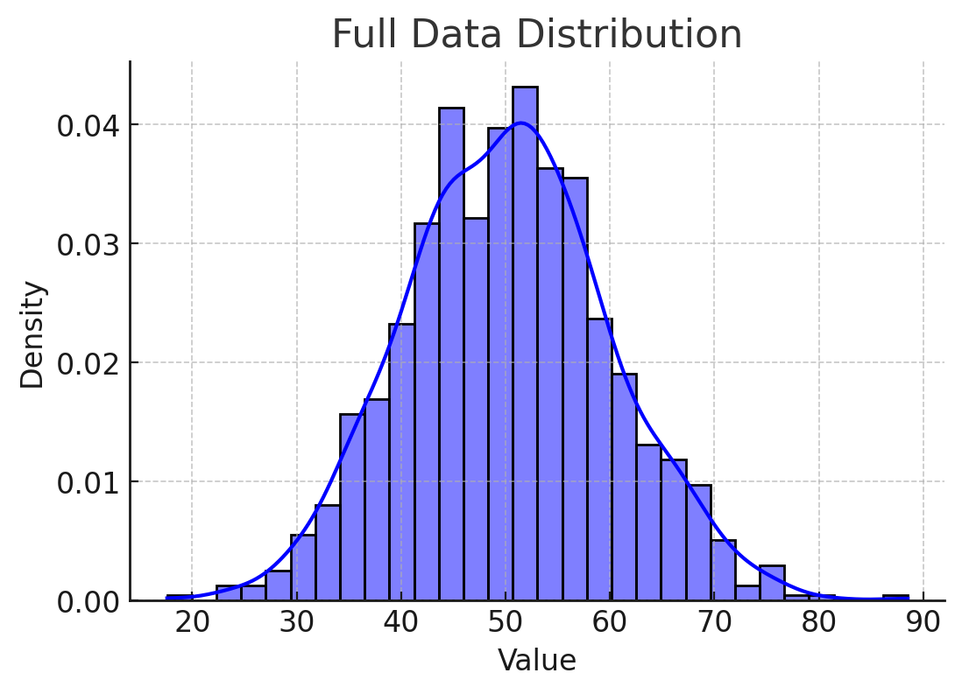
Data pre-processing steps
MISSING VALUES

Slide 20
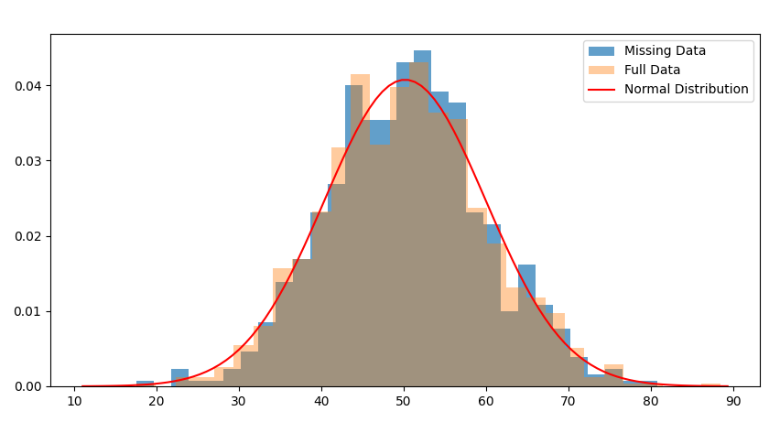
Data pre-processing steps
MISSING VALUES

Slide 21
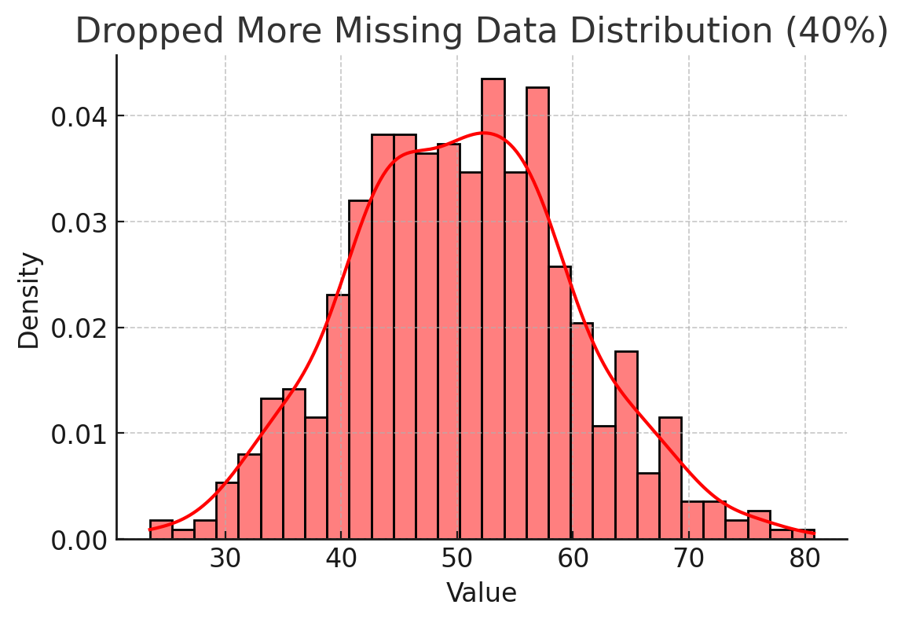
Data pre-processing steps
MISSING VALUES

Slide 22
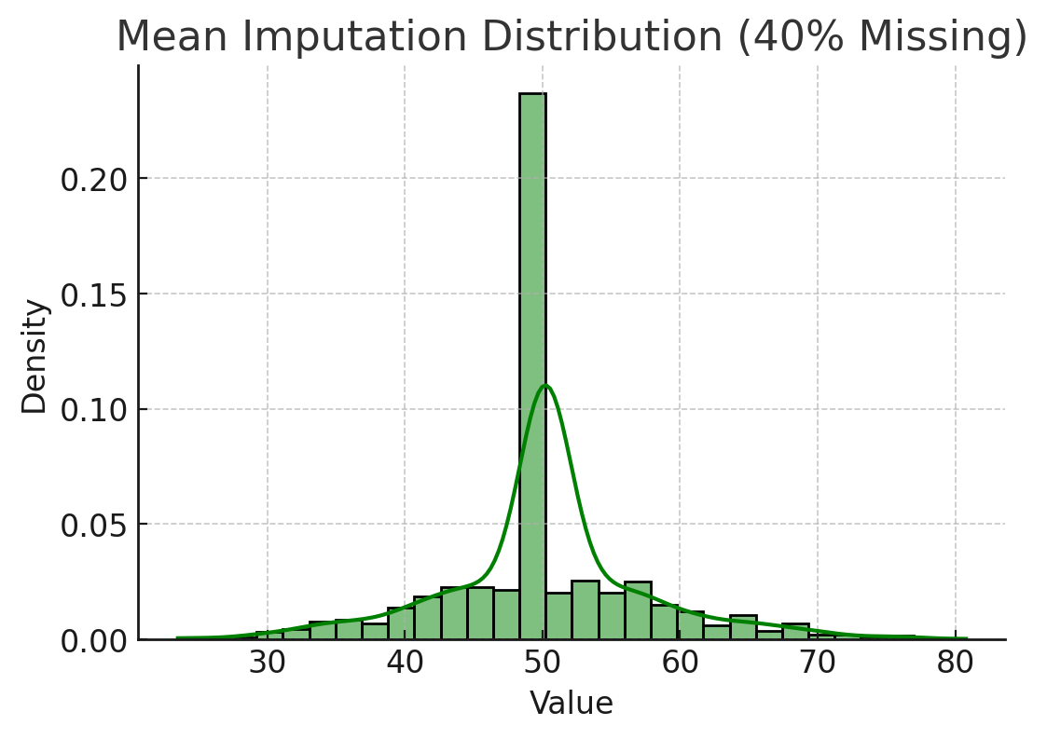
Data pre-processing steps
MISSING VALUES

Slide 23
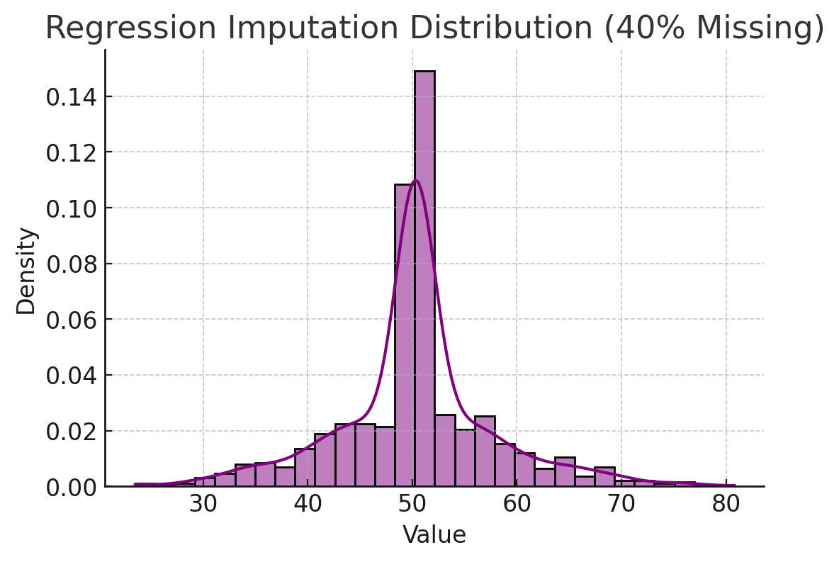
Data pre-processing steps
MISSING VALUES
predicted values often fall close to the expected average pattern

Slide 24
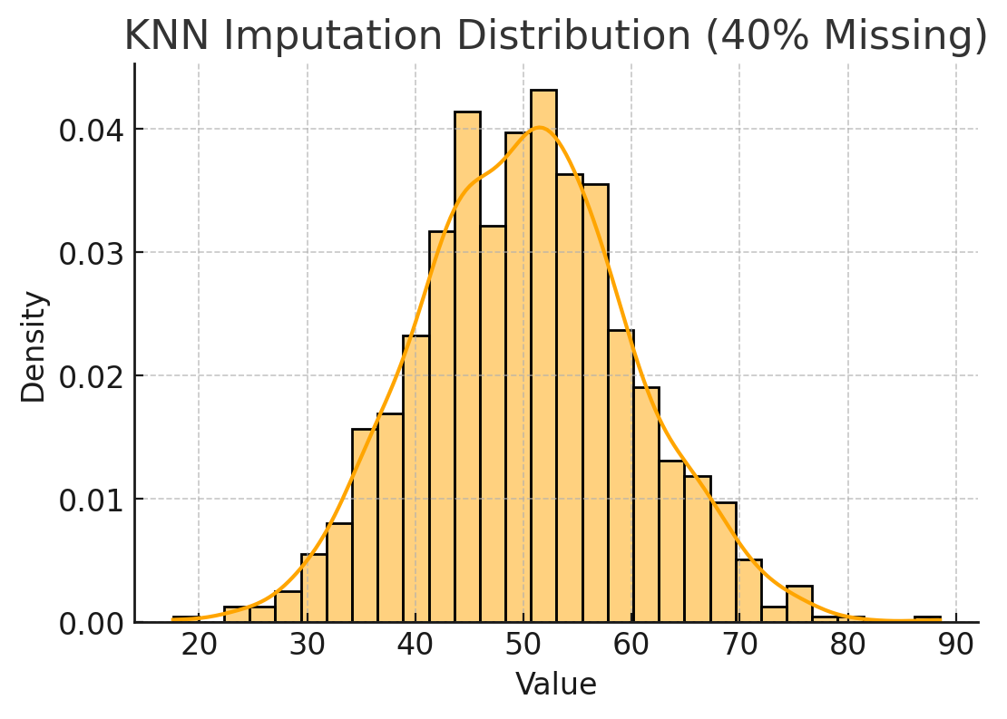
Data pre-processing steps
MISSING VALUES
each missing value is estimated from similar nearby observations

Slide 25
Data cleaning
NOISY DATA
01
Remove URLs, symbols, emojis, etc., that aren’t relevant to your analysis
02
Translate all text into the language you’ll be working in
03
Remove HTML tags
04
Remove boilerplate email text
05
Remove unnecessary blank text between words
06
Remove duplicate data

Slide 26
Data pre-processing steps
DATA TRANSFORMATION
Aggregation: Data aggregation combines all of your data together in a uniform format.
Normalization: Normalization scales your data into a regularized range so that you can compare it more accurately. For example, if you’re comparing employee loss or gain within a number of companies (some with just a dozen employees and some with 200+), you’ll have to scale them within a specified range, like -1.0 to 1.0 or 0.0 to 1.0.
Feature selection: Feature selection is the process of deciding which variables (features, characteristics, categories, etc.) are most important to your analysis.
Discreditization: Discretization pools data into smaller intervals. It’s somewhat similar to binning, but usually happens after data has been cleaned. For example, when calculating average daily exercise, rather than using the exact minutes and seconds, you could join together data to fall into 0-15 minutes, 15-30, etc.

Slide 27
Data pre-processing steps
DATA REDUCTION
Numerosity reduction: This will help with data storage and transmission. You can use a regression model, for example, to use only the data and variables that are relevant to your analysis.
Attribute selection: Similar to discreditization, attribute selection can fit your data into smaller pools. It, essentially, combines tags or features, so that tags like male/female and professor could be combined into male professor/female professor.
Dimensionality reduction: This, again, reduces the amount of data used to help facilitate analysis and downstream processes. Algorithms like K-nearest neighbors use pattern recognition to combine similar data and make it more manageable.

Slide 28







Pre-processing
TOOLS

Slide 29

Pre-processing
TOOLS
Manual Edits is always possible!

Slide 30

Pre-processing
TOOLS
Date | Country | Sales Amount (in thousands)
2023-04-03 15:01:09.235 | Canada | 666.72
2023-07-20 15:01:09.235 | United States | 920.49
2023-05-10 | Canada | 37.50
2023-09-20 15:01:09.235 | France | 372.04
2023-11-04 15:01:09.235 | South Africa | 952.16
Friday, April 20, 2024 | Japan | 350.19
2023-11-28 15:01:09.235 | Germany | 45.62
2024-01-28 15:01:09.235 | Japan | 370.24
2024-01-31 15:01:09.235 | France | 586.97
2024-02-20 15:01:09.235 | Australia | 973.36

Slide 31
Pre-processing
ACTIVITY
Task: Handling and Imputing Missing Data (GEM – Individual Data)
1. Load and Understand the Data
Import the GEM Individual dataset into your working environment (e.g., Python, R, Excel).
Inspect the dataset:
Check variable names, data types, and structure.
Identify which variables contain missing values.
2. Select Your Target
Choose:
One country (e.g., USA, Spain, India).
One variable to predict (this will be your target variable with missing values).
Clearly state your choice and justify it briefly.
3. Data Cleaning
Handle inconsistencies:
Remove duplicates.
Fix incorrect data types (e.g., strings to numeric).
Standardize categorical values if needed.
Decide how to treat:
Outliers (remove or keep with justification).
Invalid or impossible values.
4. Separate Data Based on Missingness
Split the dataset into:
“Have Data” → rows where the target variable is not missing.
“Missing Data” → rows where the target variable is missing.

Slide 32
Pre-processing
ACTIVITY
5. Analyze Missing Data (MCAR Assessment)
Investigate whether the missing data is MCAR (Missing Completely At Random).
Create visualizations, such as:
Missing value heatmaps.
Bar charts showing missing vs non-missing counts.
Correlation of missingness with other variables.
Briefly interpret:
Does the missingness appear random or systematic?
6. Train/Test Split
From the “Have Data” subset:
Split into:
Training set (e.g., 70–80%)
Testing set (20–30%)
Ensure:
Random splitting.
Reproducibility (set a random seed).
7. Model Selection and Training
Choose an appropriate model depending on your variable:
Logistic Regression (if binary outcome)
Other AI/ML models (e.g., Decision Tree, Random Forest, etc.)
Train the model using the training dataset.
Evaluate performance using the testing dataset:
Accuracy, precision, recall, etc. (depending on model type).
8. Missing Value Imputation (KNN / AI Model)
Apply a KNN imputation method or your trained model to:
Predict and fill in missing values in the “Missing Data” subset.
Clearly explain:
Why you chose this method.
How it works (briefly).

Slide 33
Pre-processing
ACTIVITY
9. Results and Validation
Compare:
Original vs imputed distributions (if possible).
Visualize results:
Before vs after imputation charts.
Comment on:
Reliability of predictions.
Any limitations.
10. Final Check
Make sure:
Your workflow is clear and reproducible.
All steps are documented.
Visualizations are labeled and explained.
11. Submission / Presentation
Be prepared to:
Explain:
Your variable choice
Your model
Your imputation results

